Slide 1
Family Law:
A View From
The Bench
Judge Bruce R. Cohen
And
Judge David B. Gass
East Valley Bar Association, January 21, 2011

Slide 2
Overview
1. Statutory factors to determine spousal maintenance.
2. Parenting Coordinators: Their authority and role.
3. Andrew R. v. Arizona DES and the Acknowledgment of Paternity under A.R.S. § 25-812.
4. Life insurance for the benefit of the other party.
5. Custody evaluation reports: What weight?
6. Presumptions: Equal Parenting Time and Custody
7. Family Court “Do's and Don'ts.”
8. Court Rule Update.

Slide 3
Spousal maintenance and
Statutory factors
When the parties divorce, each leaves with a reservoir and a pool. A spillway connects the pools.
The pools may not be the same size.
The pools may need to get smaller.
The goal is to close off the spillway by making sure that each party has a reservoir big enough to service the pool.

Slide 4
Spousal maintenance and
Statutory factors
Case law: In determining the amount and duration, "the current aim [of spousal maintenance] is to achieve independence for both parties and to require an effort toward independence by the party requesting maintenance." Schroeder v. Schroeder, 161 Ariz. 316, 321, 778 P.2d 1212, 1217 (1989) (emphasis added).
Statute: The Court must consider the statutory factors of A.R.S. § 25-319(B).

Slide 5
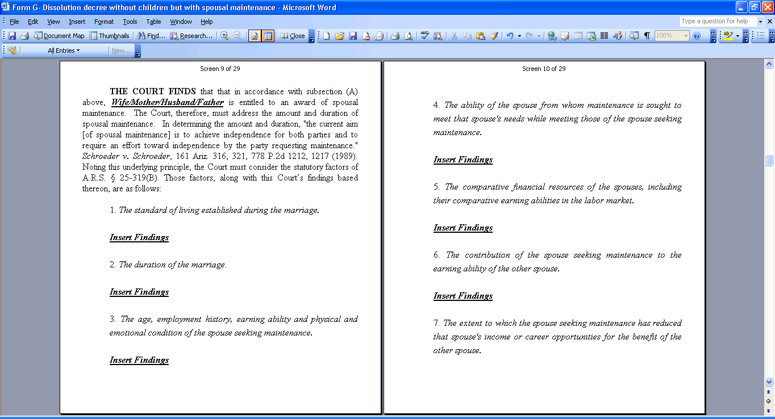
Spousal maintenance and
Statutory factors

Slide 6
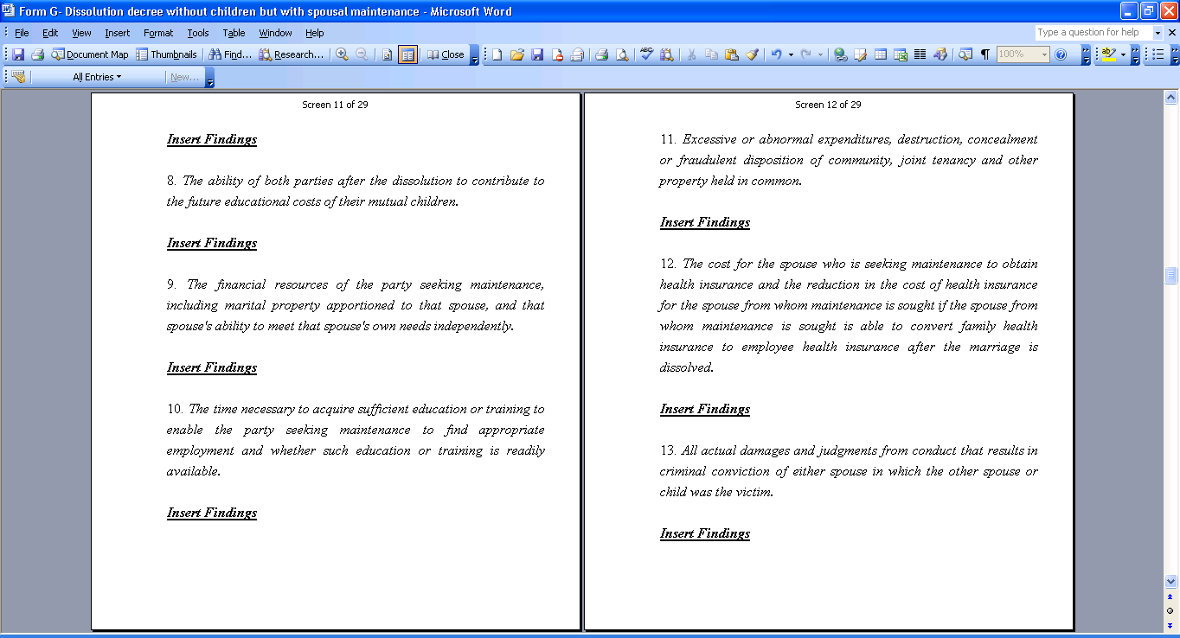
Spousal maintenance and
Statutory factors

Slide 7

Spousal maintenance and
Statutory factors
If the statute gives you a list of factors,
why not talk about all of them in order?
By Jove!
I think I am onto something.

Slide 8
Parenting Coordinators
What is a parenting coordinator’s role?
  Teach the parties to communicate and resolve conflict themselves.
  Resolve the issues that the parties cannot resolve.
What is a parenting coordinator’s authority?

Slide 9
Acknowledgment of Paternity
and Paternity Challenges
Andrew R. v. Arizona DES,
223 Ariz. 453, 224 P.3d 950 (Ariz. App. 2010)
When construing a challenge to paternity under A.R.S. § 25-812(E), the court must apply the Rule 60(c)(3) six-month time limit.
A.R.S. § 25-812(E) applies only to paternity established when the parties both execute a voluntary acknowledgement of paternity.
It stands as the law. It will control trial courts unless it is changed by the appellate courts.
Judge Weisberg dissented.

Slide 10
Life Insurance
Life insurance for the benefit
of the other party.
Only if the parties agree, as in a Consent Decree or a Rule 69 Agreement.
If the parties agree and it is included in an order, the Court will enforce the requirement.
There might be some exceptional circumstance, but it would be very fact specific.

Slide 11
Custody Evaluation
Reports
What is there evidentiary value?
How best to use them?
  Read them carefully. If you admit them, we will.
  Make sure that you have more to your case.

Slide 12
Parenting Time or
Custody
Are there presumptions?
A.R.S. § 25-403 makes the child’s best interest the primary concern.
A.R.S. § 25-103.B says:
It also is the declared public policy of this state and the general purpose of this title that absent evidence to the contrary, it is in a child's best interest:
1. To have substantial, frequent, meaningful and continuing parenting time with both parents.
2. To have both parents participate in decision-making about the child.

Slide 13
Do’s and Don’ts
DO treat everyone else in the courtroom, including court staff, with respect.
DON’T interrupt each other during arguments.
DO be prepared to ask for specific relief.
DON’T just parrot the statutory language when asking for relief.
DO prepare and submit a clear and concise pretrial statement.
DON’T submit your exhibits late.

Slide 14
Do’s and Don’ts
If the statute includes a list of factors, DO cover each, even if it is to just point out that the factor does not apply.
DON’T comment on an answer, and DON’T thank the witness for an answer.
DO use signposts, such as telling the witness, “We are going to cover child support now.”
DON’T forget jurisdictional testimony.

Slide 15
Do’s and Don’ts
DO remember that it is your client’s life, not your life. Always maintain your professionalism.
DO be prepared.

Slide 16
Court Rule Update
Rules 5.1, 47, 67(b), 69, 74 & 78, A.R.F.L.P.
R-09-0042
Approved
Allows for temporary orders in non-parent custody cases
Establishes procedures for consolidating and transferring dependency and custody proceedings, and deferring jurisdiction
Allows court to appoint a judge pro tempore as a private mediator, who then may approve Rule 69 agreements and sign decrees (In re Marriage of Reeder v. Johnson, -- Ariz. --, -- P.3d --, 2010 WL 3339457 (Ariz. Ct. App. Div. 1, 2010))
Clarifies Rule 69 agreement procedures

Slide 17
Court Rule Update
Rules 5.1, 47, 67(b), 69, 74 & 78, A.R.F.L.P.
R-09-0042
(Continued)
Approved
Precludes counsel from attending parenting coordinator meetings
Provides that offers of judgment are not permitted in family cases

Slide 18
Court Rule Update
Rule 6(E)(4)(e)(2), Rules of Protective Order Procedure
R-09-0045
Rejected
Would have repealed as unconstitutional the provision authorizing a judicial officer to prohibit a defendant from possessing, purchasing, or receiving firearms and ammunition for the duration of an injunction against harassment

Slide 19
Court Rule Update
Rule 1(D)(4), Rules of Protective Order Procedure
R-10-0013
Rejected
Would have permitted the court to direct a defendant to remain in the courtroom for a period of time after the plaintiff is excused only in cases in which an order of protection or an injunction against harassment remains in force

Slide 20
Court Rule Update
Rule 1(B)(1)(d), Rules of Protective Order Procedure
R-10-0014
Rejected
Would have replaced the term "victim" in the rules with "plaintiff" or, in appropriate situations, "alleged victim”

